Slide 1
AOMcontrol Experiments Programming Guide
August 2014
–
wmharmening@gmail.com

Slide 2
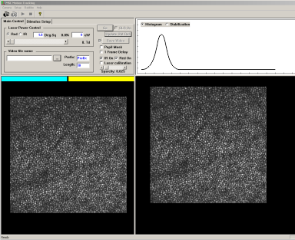
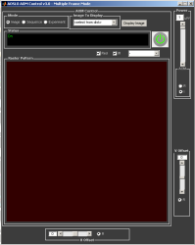
Software Structure Overview
Language:
C++
Matlab
Modified by:
Admin
User
MSCGui
Low-level
commands
Image stabilization, retinal tracking,
video acquisition, rudimentary stimulus
control (e.g. flash frequency, tracking gain,
etc.), retinal location selection by
mouse clicking. Provides drive signals to
control AOM voltages.
[MSC: Map Seeking Circuit algorithm]
AOMcontrol
Mov struct,
aka ‘sequence’
Interface converting user defined
display items into MSCGui usable format,
provides visible feedback to operator
during experiments, manages
experimental files in selectable list
Experiment
User defines experimental design,
stimulus geometry, number of trials, etc.
in experimental file and possible auxiliary files (Config window) and subroutines, see following pages.

Slide 3
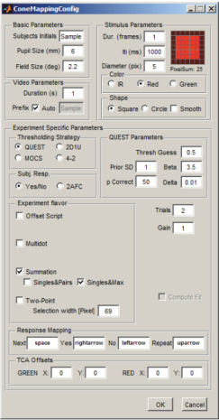
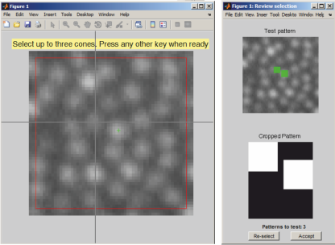
Experiment Structure
Presence:
must
option
This structure of files and their dependencies is a product of a grown and ongoing development and is by no means optimal. Improvements are very possible and welcome.
Experiment file, ConeMapping.m
CFG struct
Experiment Config
user interface,
ConeMappingConfig.m
User defined
parameters, e.g.
trial sequence
.fig,
mandatory with
Config window
Experiment subroutines, e.g. summation.m
Config window definition, ConeMappingConfig.fig

Slide 4
Experiment file e.g. ConeMapping.m (in ‘Experiment’ folder)
Does
Controls AOMcontrol behavior during experiment (e.g. subject input controls, trial progression rules)
Provides necessary parameters for AOMcontrol (e.g. StimParams, SYSPARAMS, VideoParams)
Creates struct Mov for AOMcontrol’s Playmovie function
Creates psychophysical result files (.mat) for analysis after experiment
Needs
Has to reside in Experiment subfolder for it to appear in AOMcontrol’s experiment dropdown list
Depending on usage needs external Config window (e.g. stimulus size, wavelength, etc.) and subroutines for advanced user input (e.g. for cone-targeted stimulus definition)

Slide 5
Experiment file e.g. ConeMapping.m (in ‘Experiment’ folder)
To
Edit
List specific functions and variables to edit

Slide 6
Experiment subroutine e.g. summation.m (in AOMcontrol main folder)
Does
Controls additional experiment parameters that are too specific for experiment base files, e.g. cone targeted stimulus positions
Provides trial sequence for main experiment routine
Needs
Uses additional scripts for advanced functionality, e.g. to produce a frame averaged image to select cones for stimulation
Resides in AOMcontrol main folder

Slide 7
Experiment subroutine e.g. summation.m (in AOMcontrol main folder)
To
Edit
List specific functions and variables to edit

Slide 8
Experiment config user interface e.g. ConeMappingConfig.m (in ‘Experiment’ folder)
Does
Aka ‘the config window’, defines experiment parameters in a more user friendly way
Populates CFG struct for experiment file
Saves current gui settings in .mat file (in AOMcontrol folder, e.g. lastSensitivityCFG.mat)
Can be re-used for multiple experiment files
Needs
Best created through Matlab’s GUIDE
.m and .fig file have to reside in the same folder
Dependencies between .m and .fig are best handled by Matlab, e.g. file name changes should be done by ‘Save as…’ command in GUIDE.

Slide 9
Experiment config user interface e.g. ConeMappingConfig.m (in ‘Experiment’ folder)
To
Edit
OpeningFcn Handles loading in last values and setting some initial values
Ok_button_Callback Is the time when element values get passed to CFG struct
Load last values Default values (if no lastCFG.mat is found) are set here
drawPreview Controls stimulus depiction in little inset in config window. Careful, this needs to be consistent with the actual stimulus definition in experiment file, if preview should be meaningful

Slide 10
Config window definiton e.g. ConeMappingConfig.fig (in ‘Experiment’ folder)
Does
Controls window and interface element layout, definition of element names (tags) and their function (callbacks)
Needs
Can only be edited through Matlab’s GUIDE
Corresponding .m and .fig file have to reside in the same folder
Dependencies between .m and .fig are best handled by Matlab, e.g. file name changes should be done by ‘Save as…’ command in GUIDE.
Tags of interface elements (e.g. edit text field, radio buttons, etc.) best changed with Property editor of GUIDE

Slide 11
Config window definiton e.g. ConeMappingConfig.fig (in ‘Experiment’ folder)
To
Edit
New elements position and size (choose by pixel, character, etc.

Slide 12
Structure Overview
Language:
C++
Matlab
Modified by:
Admin
User
MSC
sending voltages
to AOMs
Presence:
must
option
Mov.struct,
aka ‘sequence’
AOMcontrol
Mov.struct,
aka ‘sequence’
Experiment file, ConeMapping.m
CFG.struct
Experiment Config
user interface,
ConeMappingConfig.m
User defined
parameters, e.g.
trial sequence
.fig,
mandatory with
Config window
Config window definition, ConeMappingConfig.fig
Experiment subroutines, summation.m

